Slide 1
New algo for Cond Number analysis using 2x2 in the diagonal as in theo 6.2
Results run of 2/9/29
>> run_diag2x2_study
==== RUN SUMMARY ====
Accepted matrices: 35
Runtime: 3795.0 sec (63.2 min)
log10(condA) stats:
min = 8.020
p05 = 8.049
p25 = 8.145
median= 8.278
p75 = 8.879
p95 = 10.695
max = 11.970
Correlation:
corr(log10(condA), log10(min_qdet)) = -0.022

Slide 2
Prog start
function G = run_diag2x2_study()
% Main runner for 2x2-diagonal pivot study vs global cond(A).
%
% Output:
% G = per-matrix summary table (only matrices that pass threshold)
% ---- defaults (edit here) ----
n = 1000; -- dim 1000x1000
N = 50000; % trials to generate
kappa_thresh = 1e8; -- cond num of 100,000,000 min
rng(1); % reproducible

Slide 3
“Numerical experiments on random 1000×1000 matrices show that extreme ill-conditioning is always accompanied by strong cancellation in at least one 2×2 diagonal block. However, the magnitude of the global condition number is not directly proportional to the smallest such determinant. This indicates that local 2×2 instability acts as a necessary trigger, while the propagation of instability through Schur complement interactions determines the final conditioning.”

Slide 4
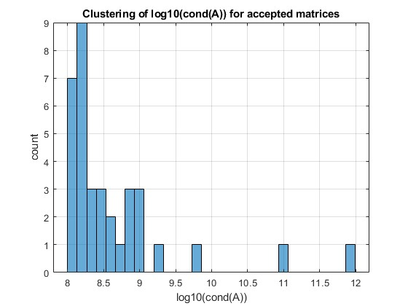

Slide 5
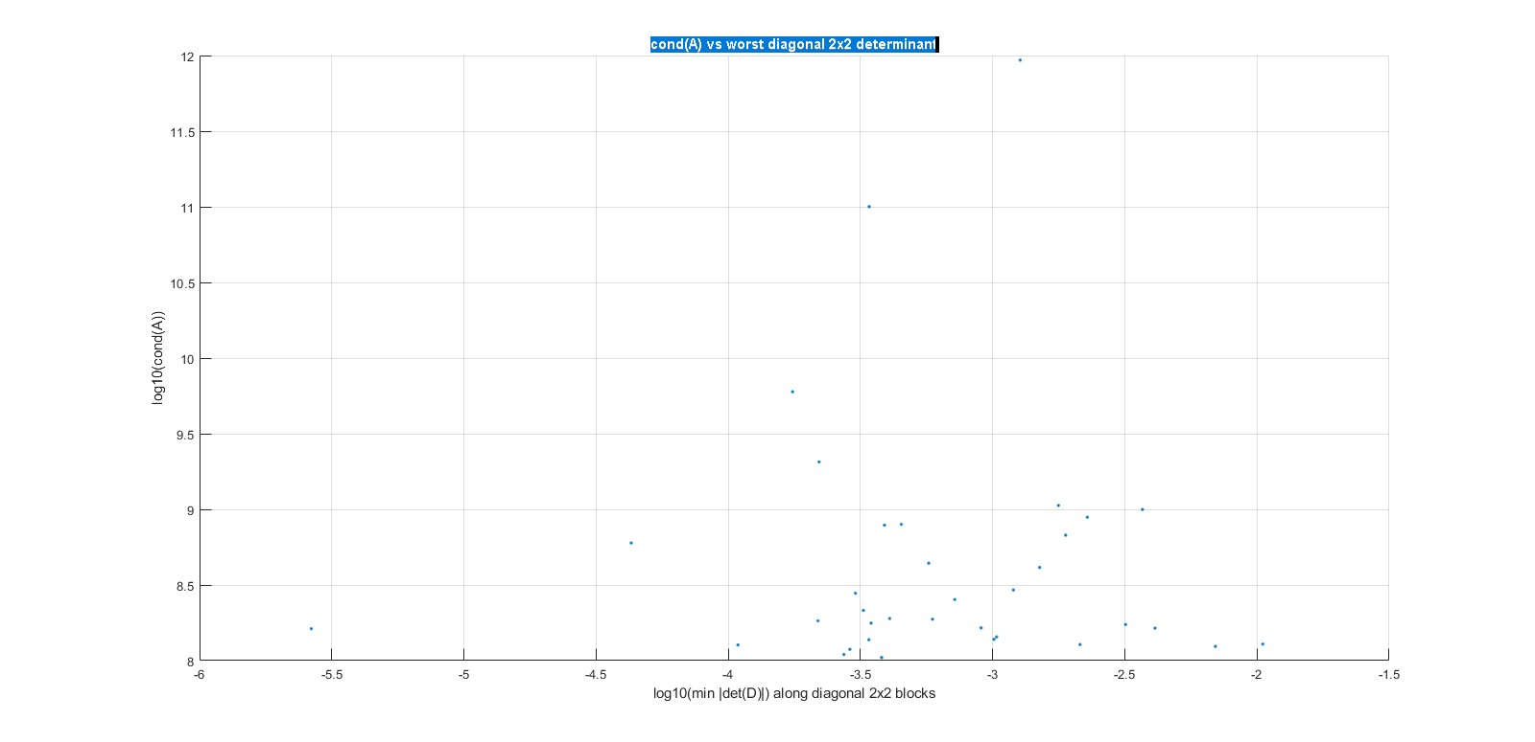

Slide 6
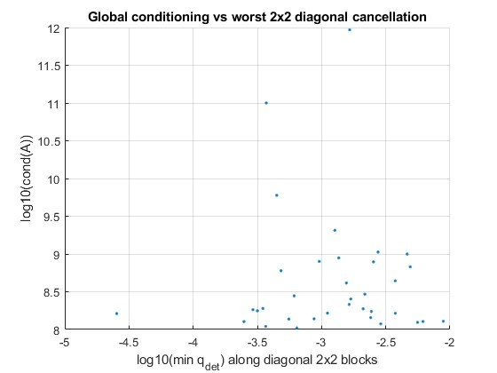

Slide 7
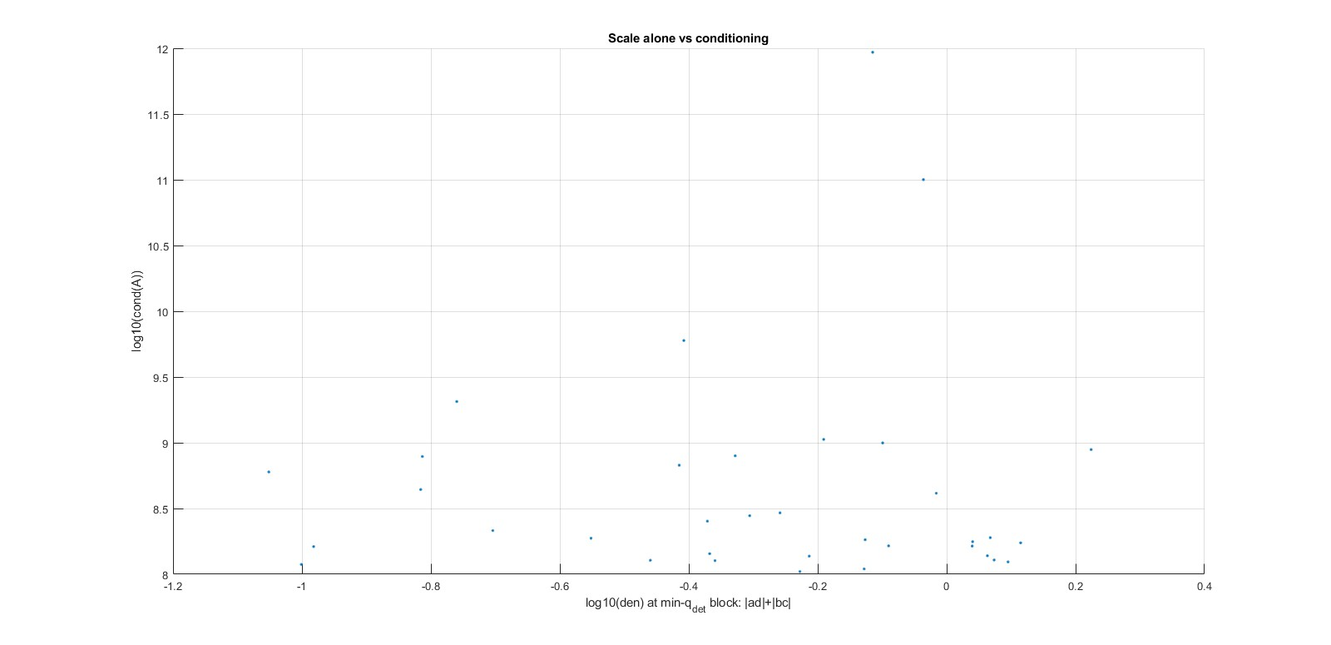

Slide 8
Saved: diag2x2_results_n1000_20260209_233204.mat
22422 2.9318e+08 0.0021735 0.0011983 0.55133 316
23165 1.8786e+08 0.0021094 0.00059229 0.28079 273
24826 2.0571e+09 0.0012689 0.00022059 0.17384 291
24998 1.2768e+08 0.0061695 0.0021411 0.34704 410
31005 1.6448e+08 0.001113 0.00090465 0.81283 467
36807 2.5333e+08 0.0016901 0.00071905 0.42545 304
36924 6.7442e+08 0.0049087 0.0018886 0.38475 382
37098 9.972e+08 0.0046354 0.0036885 0.79572 46
37949 5.9901e+09 0.00044758 0.00017509 0.39118 198
38699 7.9569e+08 0.00096096 0.00045152 0.46986 151
39465 5.9942e+08 0.00048332 4.294e-05 0.088845 221
40008 1.6235e+08 2.5393e-05 2.6475e-06 0.10426 220
42374 1.3733e+08 0.00055615 0.00034041 0.61208 290
44395 2.7899e+08 0.0006117 0.00030266 0.49478 201
45076 9.3244e+11 0.0016556 0.0012712 0.76784 301
45299 1.2839e+08 0.0088787 0.010521 1.185 203
45652 1.4332e+08 0.0024147 0.0010358 0.42895 247
46501 1.048e+08 0.00064222 0.00038019 0.59201 20
48422 8.8732e+08 0.0013614 0.0022809 1.6755 2

Slide 9
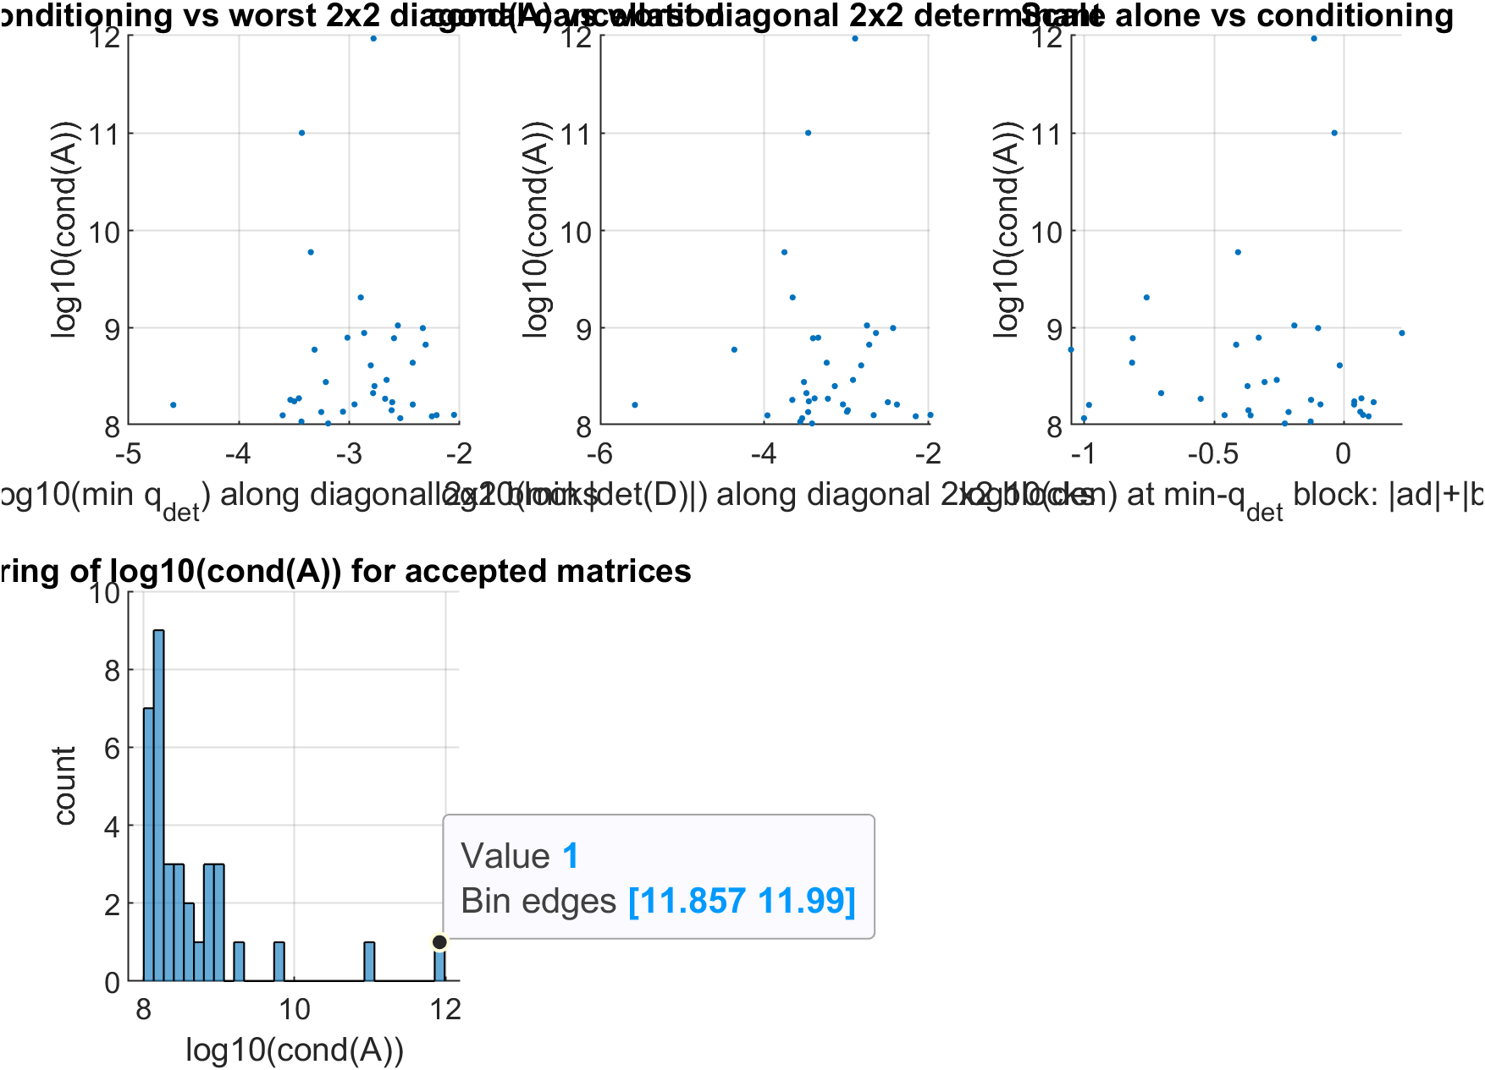

Slide 10


